Slide 1




Streamline your meetings

Slide 2

Problem Definition
71% of senior execs feel meetings are inefficient
Meetings have increased by 21% since the covd-19 pandemic
Inefficient meetings cost up to $283 Billion in the U.S.A.

Slide 3

Problem Definition
Technical issues
Human Issues

Slide 4
We help companies to get more out of their meetings, by offering an integrated suite of cutting-edge software and advanced AI-based diagnostics

Slide 5


Slide 6
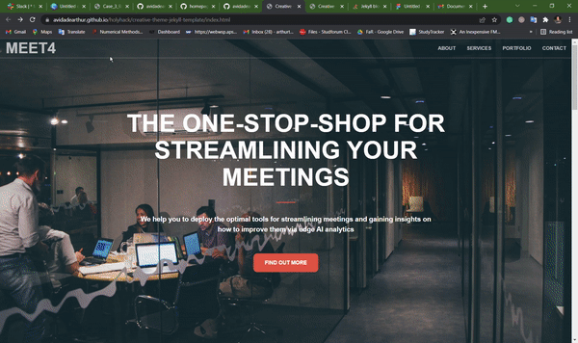
Product – Marketplace

Slide 7
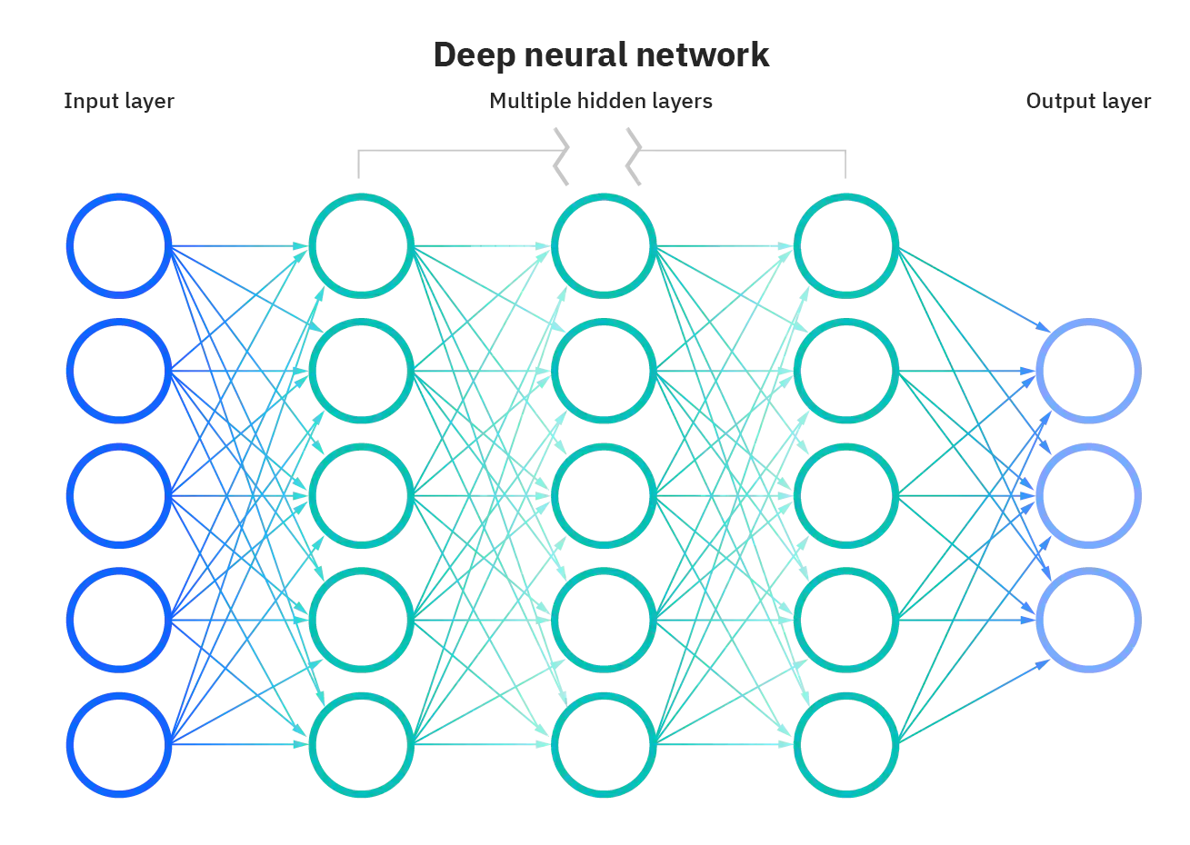
Product - Recommendation engine
Human feedback
Predict Relevant Features
Generate Report

Slide 8



Business Model
DevOps Maintenance
Feature Development
Development
Costs
Product
Marketing services
Subscription fees
Back-end
Revenue
Front-end
Revenue
Partners
Clients
Sales Kickbacks
Consulting Revenue
Market
Sales &
Marketing
Direct Sales
Direct Sales
Notes:
Voice records: Kate never stores the actual voice records, but I called customer service and they keep my conversation for 10 years. → should be 6 months by default, unless there is the chance they would sell me an investment product. I called for a complaint........
KBC does not sell your data, but they do create aggregated insights out of it and use it to train models. So they kinda do sell it.
1M30s
Data Maximization (Onfido, social media, Black Tiger...)
Non-Aggregated storage (i.e. individual records used, not
aggregated metrics)
Sharing data with market research agencies for analysis
- risk of de-anonymization due to many tracked
parameters (Unlikely)
Address visible when receiving payments
Loose ends GDPR: removal request can often not be
Fulfilled in case of third-party owned data
Straight through processes (STP) vs. Non-STP: human-
in-the-loop = privacy threat. (Non-encrypted chat?)
Under-investment in security due to conflict of interest
‚No selling of data‘ → misleading privacy statement

Slide 9
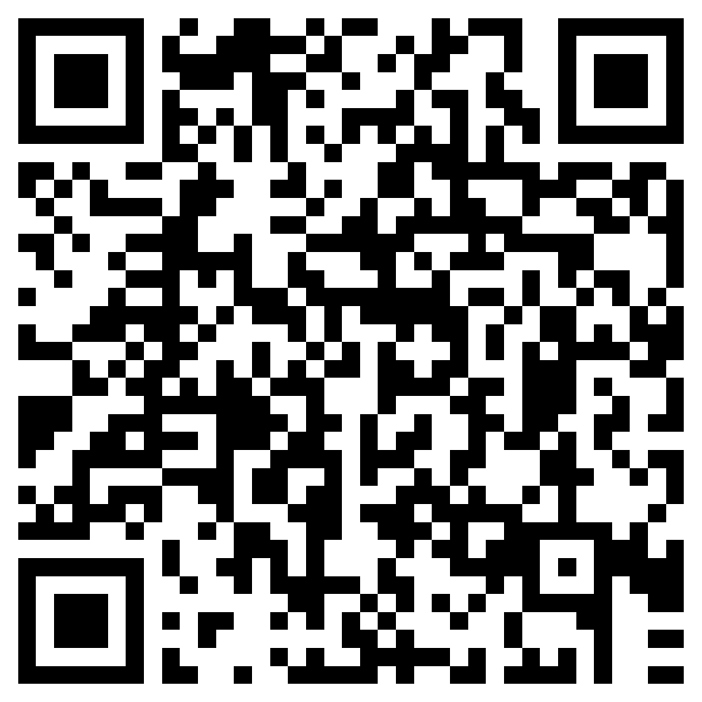
Check out our website!

